Slide 1


Oil and Gross Domestic Product of USA
Project-1

Slide 2
Is there a relation between Oil Prices and Gross Domestic Product?
What is GDP? The GDP is the market value of all goods and services produced in a nation during a specific time period.
Oil is purchased in $ Dollar worldwide.

Slide 3
¿Questions asked by me?
Can we use government data to possibly predict future economic expansion or contraction based on oil prices?
Does economic expansion or contraction affect Oil prices or does Oil price affect the economy?
Is there correlation between falling oil prices and negative GDP?
As the world is moving away from fossil fuels, will this shift impact how oil prices impact our economy?

Slide 4
Data Sources
Yearly Gross Domestic Product of USA - Bureau of Economic Analysis (CSV)
Yearly Oil Price Data (93-2020) – U.S. Energy Information Administration (CSV)
Electric Vehicle Data (2011-2019) – U.S. Department Of Energy (CSV)

Slide 5
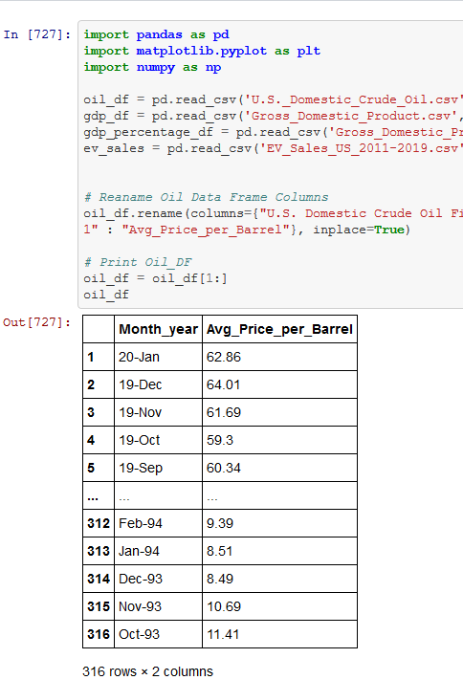
Data Cleanup & Exploration
I used Pandas, Matplotlib and numpy to clean up the data I pulled from government websites. Pandas was very useful to filter out what information I was looking for.
Issues I encountered were data formats that were inconsistent. For example, the oil data month section. The data was a certain way for some years and then a different way for the remaining years.
I had to use different functions to align and get data that I wanted.
When I formatted data, I would have to realign indexes and figure out how to clean up data so take care of errors.

Slide 6
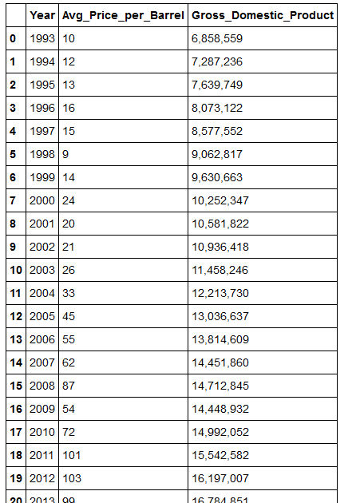
Data Analysis
Once I was able to create the data frames that I desired, that is when I started getting answers of the questions I was asking.
The oil data that I pulled from BEA was from 1993 until Jan 2020. I thought this was good enough, since it is almost 30 years of oil Data and in my lifetime.
I decided to use the US GDP from 1993 until 2019 to hopefully to better align my data.

Slide 7
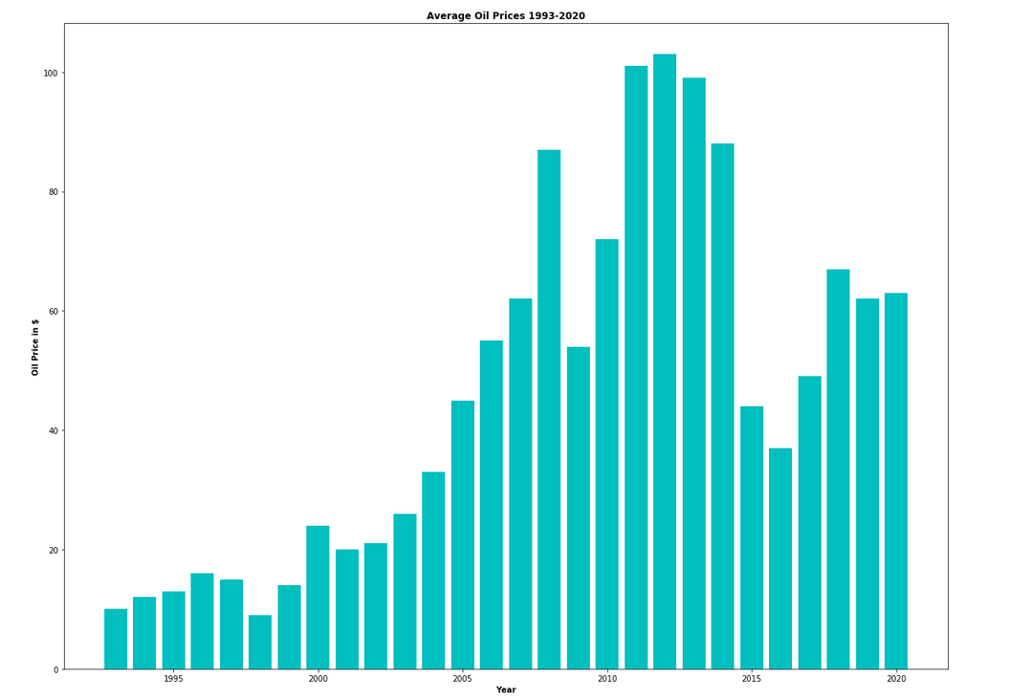

Slide 8
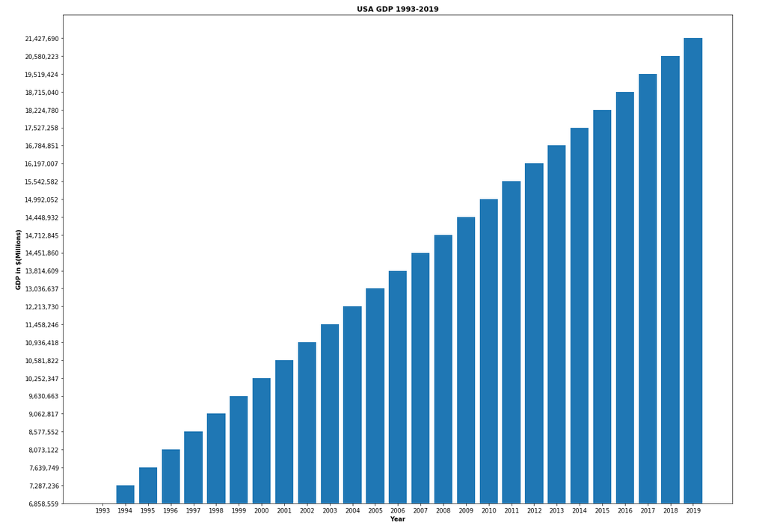

Slide 9
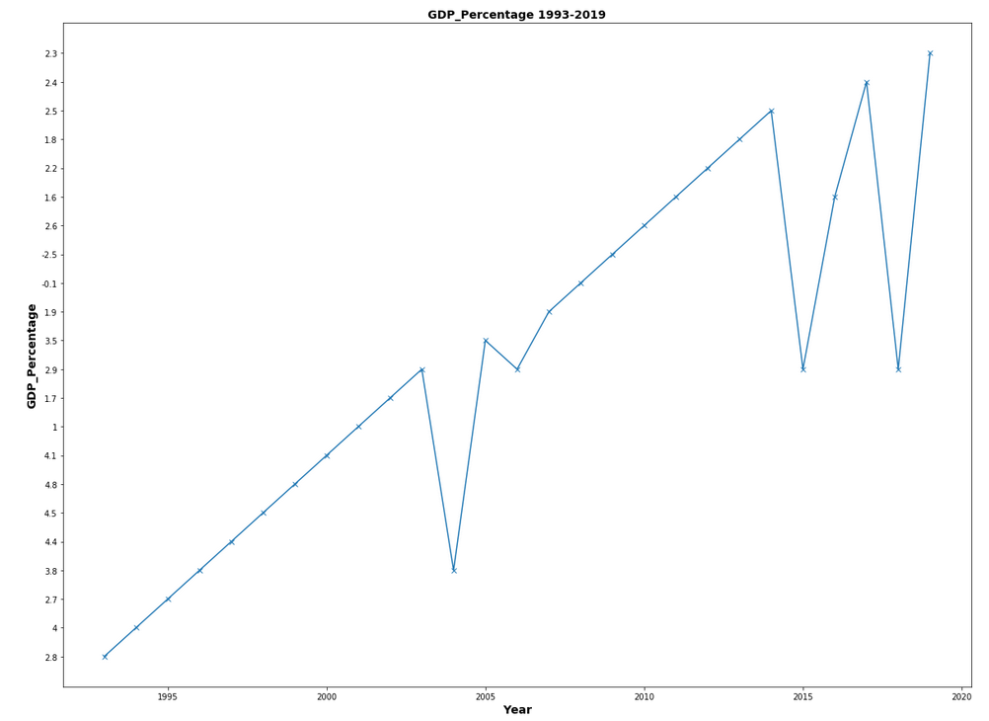

Slide 10
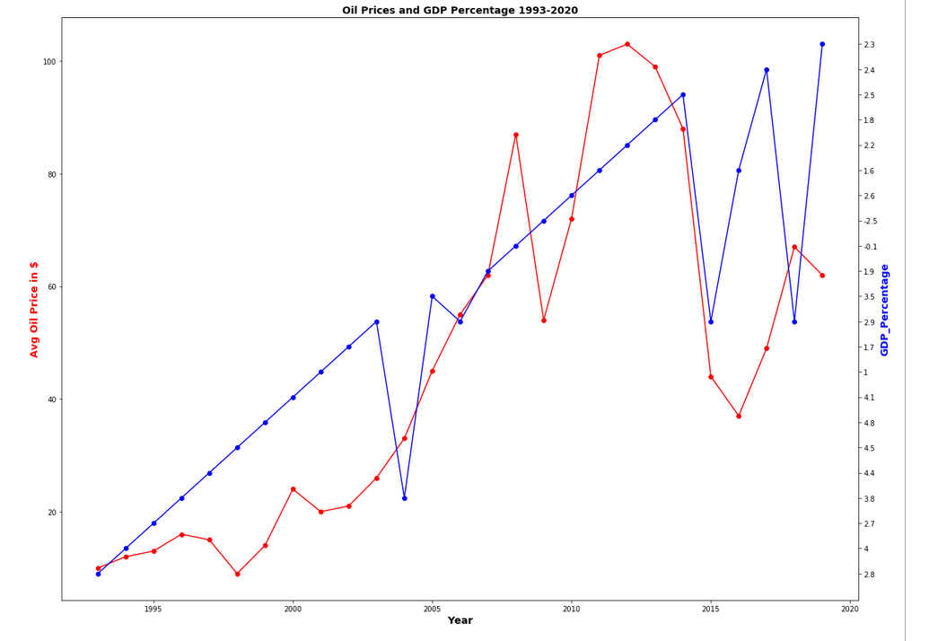

Slide 11
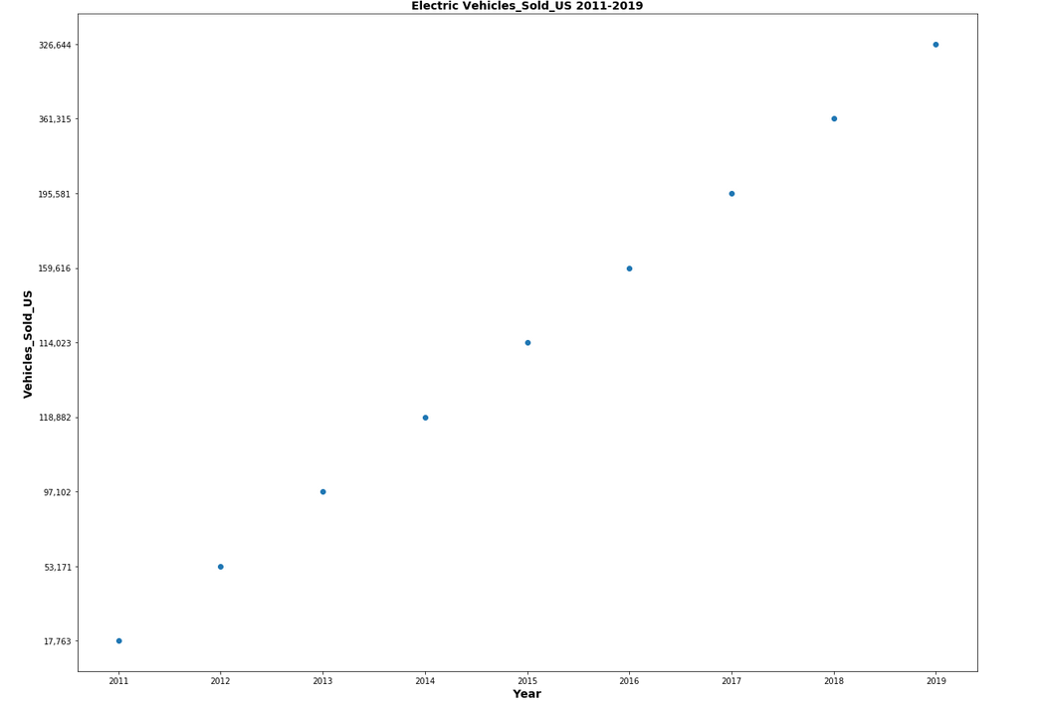

Slide 12
Conclusions
After pulling and analyzing this data, it is not clear to me, if oil prices factor into Gross Domestic Product of the USA. There was a hint of correlation based on Oil Price and GDP percentage, but I do not think this has an affect on the overall macro outlook.
Oil is sold in US Dollars, so my thinking was that it would have a much more profound effect on the broader economic outlook. I could not make a solid analysis based on the data I pulled.
More data needs to be analyzed (unemployment, inflation, labor market participation.
Now that public conscious is shifting towards renewal energy and away from Fossil fuels, Electric Vehicles sales keep increasing and lowering the demand for oil / gas.
Soon Oil might be completely irrelevant but only time will tell.

